Slide 1
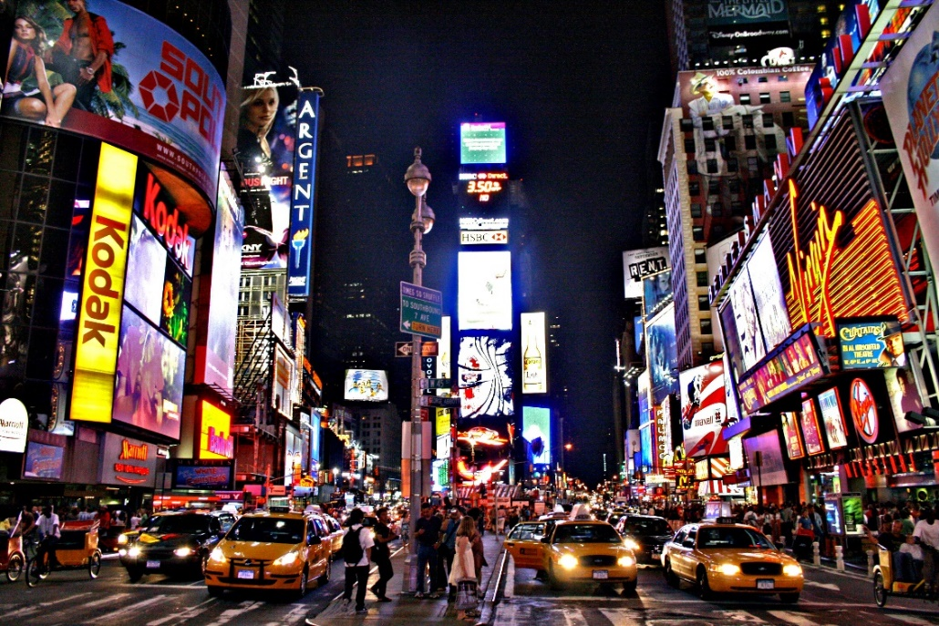
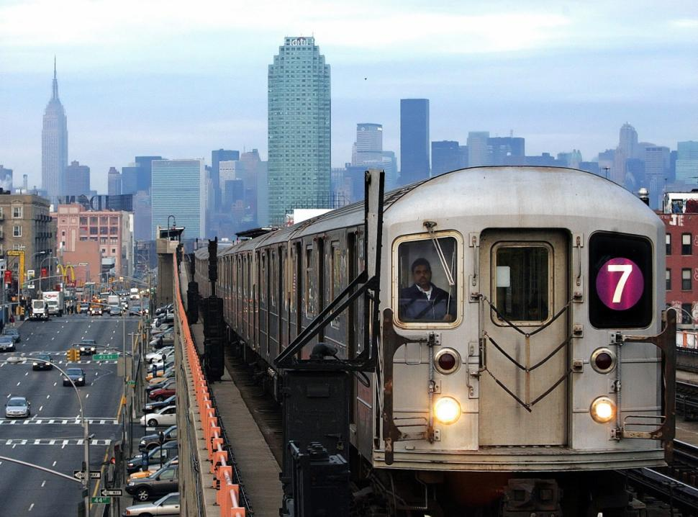
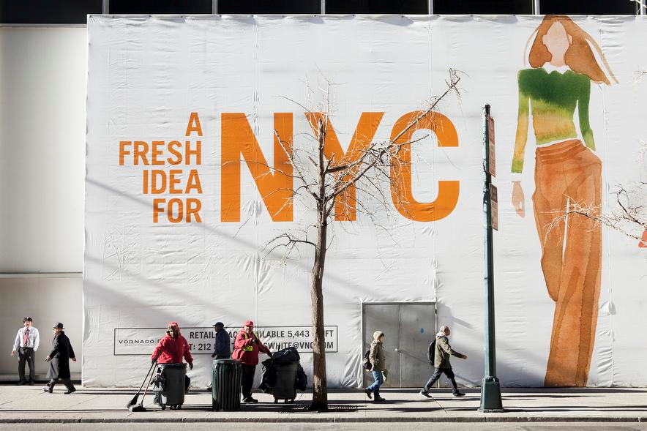
Ads in the City!
Comparing Advertisements in Harlem and Tribeca
Tasha McKenzie
Liliana Ramos
Deirdre O’Callaghan
Arielle Chisolm
Gabby Reyes
Rahul Gopalakrishnan
Kendel Jennings
Myesha Grandsoult
Sophia Grunin

Slide 2
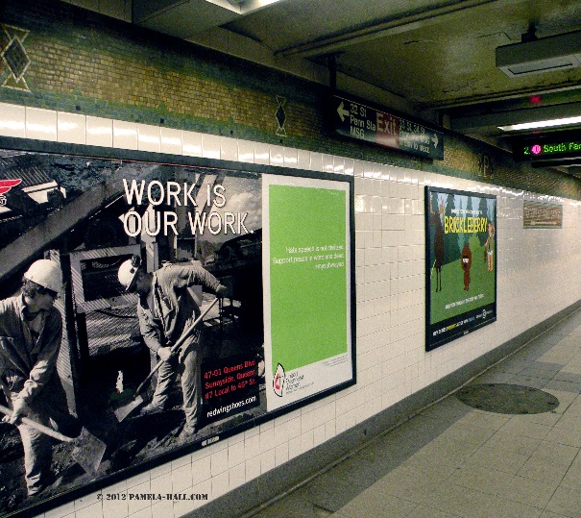
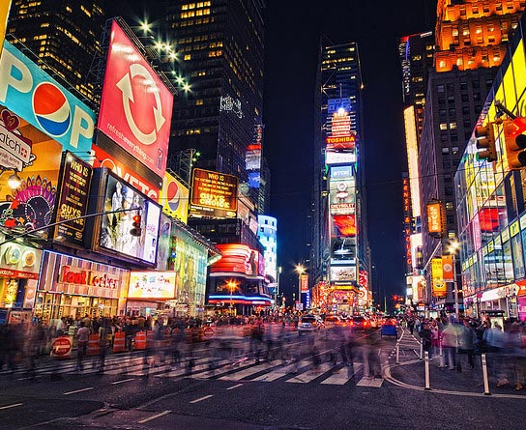
What is Advertising?
"Advertising is the nonpersonal communication of information usually paid for and usually persuasive in nature about products, services or ideas by identified sponsors through the various media.“ (Bovee, 1992)
A person living in a city can be exposed to up to 5,000 ads in a single day
About ½ of the 4,110 people interviewed said they believed advertising today is out of control. (Yankelovich, 2008)
Notes:
We see advertisements every day: on the streets, on public transportation, on the internet, etc. But what are advertisements? According to Courtland Bovee,...
we could not find any NYC-specific data, but the numbers would probably be similar to or higher than 5,000/day

Slide 3
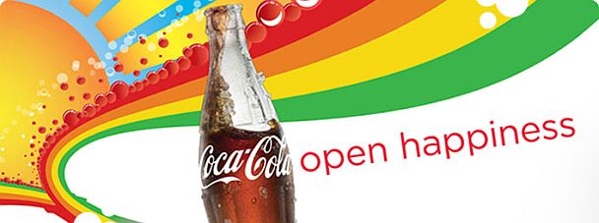

How Advertising Works:
Explicit cognition – conscous
Implicit congiton – unconscious
Priming: Different factors can very subtly influence and alter a person’s unconscious mind, leading to changes in behavior
(Herbert, 2011)
Consumer cognition may be both implicit and explicit
Ads create positive feelings and memories that we associate with a particular brand
Via this process, we are encouraged to buy a product at a later date
Stories, songs/jingles, and images create a focus on the brand
(Hollis, 2011)
Notes:
ex: Children who are shown an advertisement for junk food are more likely to eat while watching a cartoon than children who were primed with a non-food related advertisement. (Harris et al. (2009)); --PRIMING
ex. Messages such as “Drink Coca-Cola” presented for 1/3000th of a second increased the sale of Coca-Cola in a movie screening by 18.1%--IMPLICIT COGNITION
ex. Coca-Cola’s advertising campaign “Make it Happy” and #choosehappiness, people who view these ads will associate Coca-Cola with a positive feeling/happiness (aim of the ads), might make you purchase coca
ex. the Folgers jingle, “The best part of waking up is Folgers in your cup.” instantly recognizable, positive associations, etc.

Slide 4

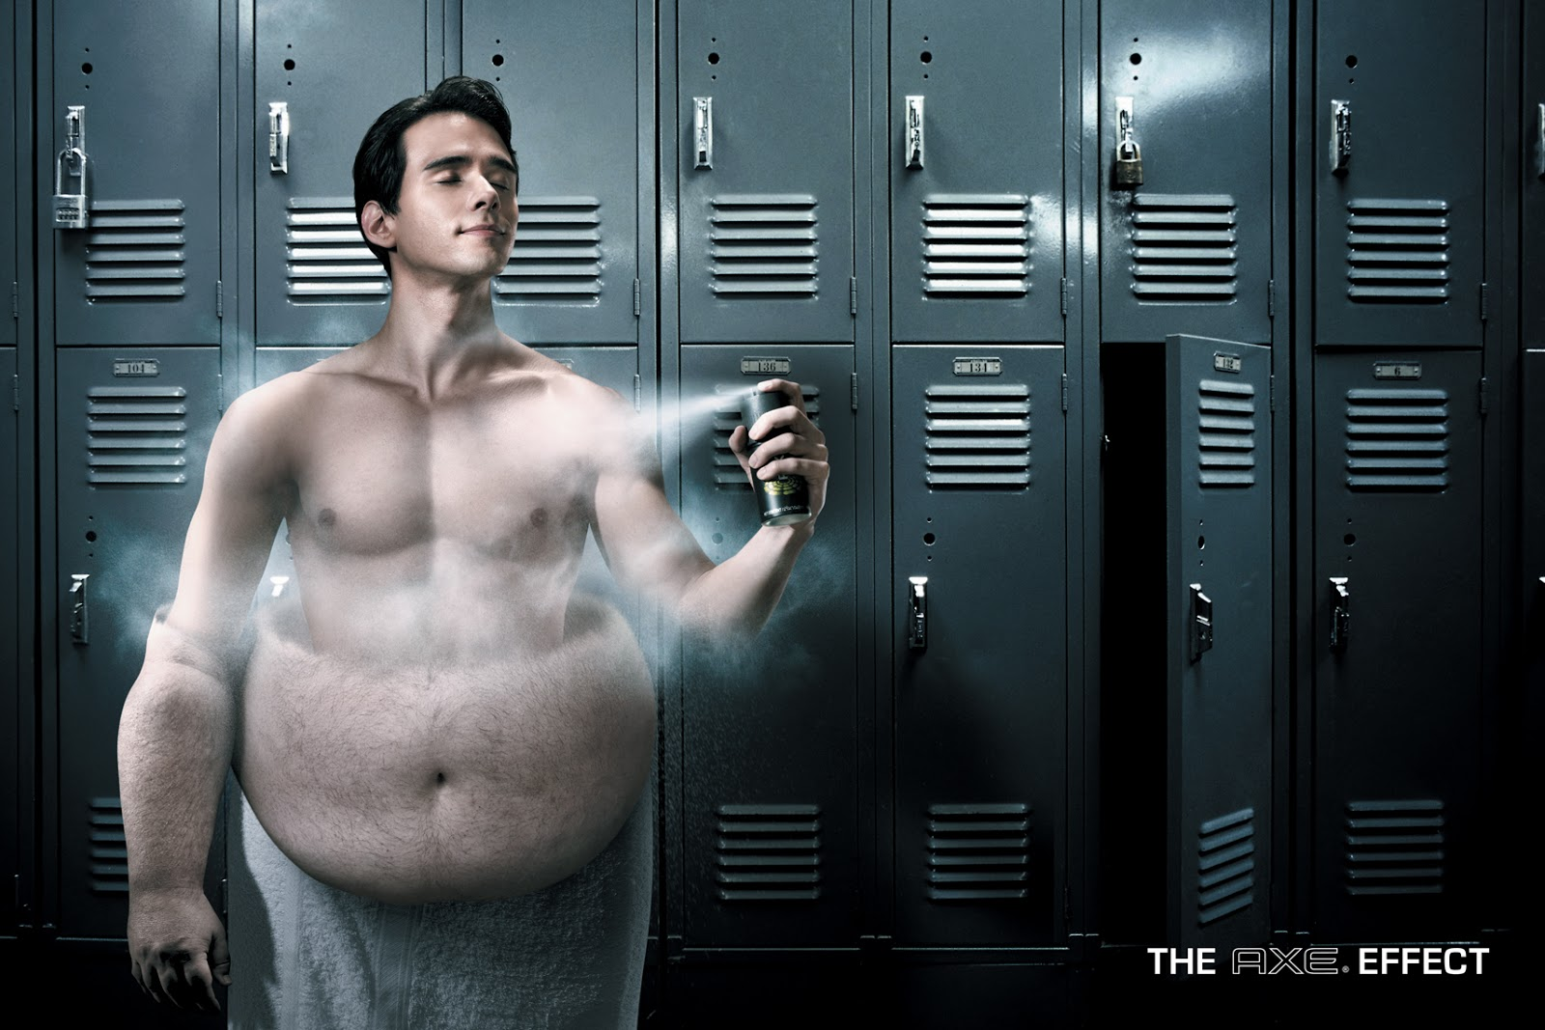
Effects of Advertising
Positive
Encourages economy, creates jobs
(Morley 2015)
Public Service Announcements
(e.g., promoting physical/mental health or safety)
Negative
Negative health messages
(Samuels et al., 2007)
Unrealistic expectations
Promotion of stereotypes (Finn, 2015)
Notes:
ex. ads about the dangers of smoking and the harmful health effects
ex. Products such as alcohol and cigarettes may be promoted
ex. one may expect that a particular clothing or makeup brand will make them gorgeous or that a medication will cure them of their disease
ex. ONLY women taking care of children, etc.

Slide 5
Targeting and Advertisements
Targeting - marketing that is aimed at a set of buyers who share common needs and characteristics
(Kotler, Armstrong,& Starr 1991)
Perceived similarity/dissimilarity
(DiMeo & Whittler, 1991)
Racial targeting is when media specifically targets one racial group (Green, 1999)
Advertising of alcohol and other unhealthy products is concentrated in racial/ethnic minority areas
Notes:
Perceived similarity: the perception of dissimilarity should reduce message persuasion; viewers with racial sensitivities may infer that a racially dissimilar actor has different attitudes; high-prejudice whites struggle to identify with a black actor
Tie to lower socioeconomic neighborhoods, more targeting to unhealthy things

Slide 6
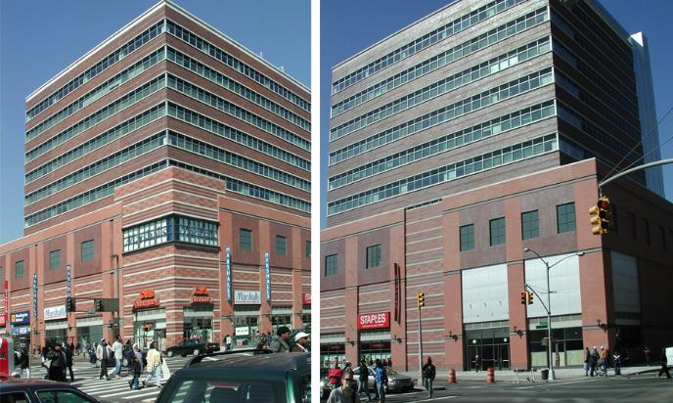
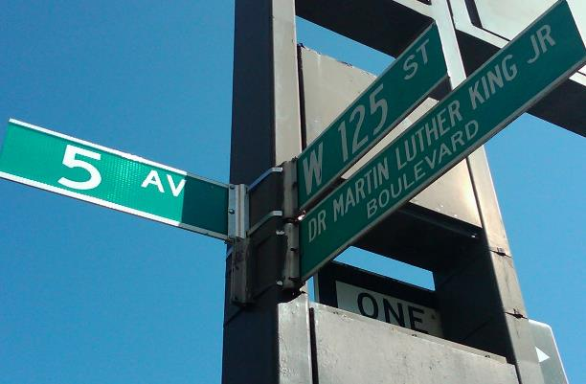
CENTRAL HARLEM
Harlem is a large neighborhood within the northern section of the NYC borough of Manhattan. Since the 1920’s Harlem has been known as a major African American residential, cultural, and business center.

Slide 7
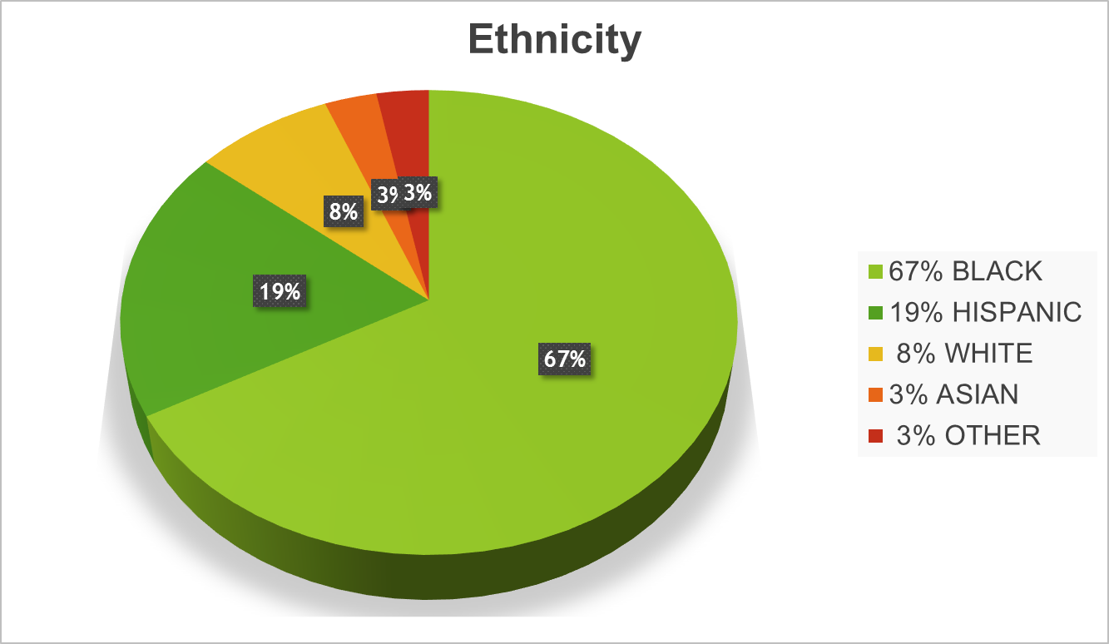
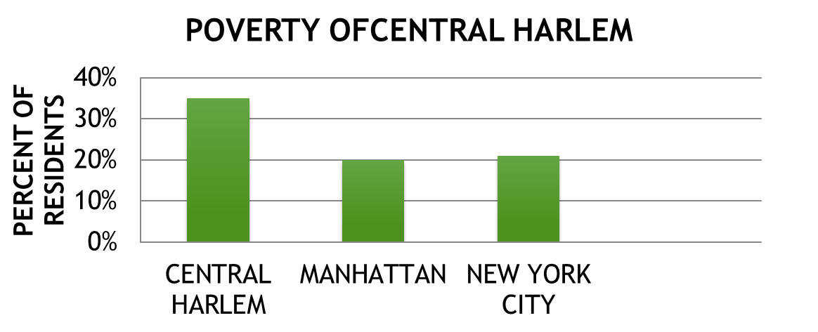
Demographics in Central Harlem
Average income in Harlem is $40,000
More people live below the poverty line in Harlem than in other neighborhood in NY
20% of residents have a BA degree
(Data Source: US Census 2000/NYC Department of City Planning)

Slide 8
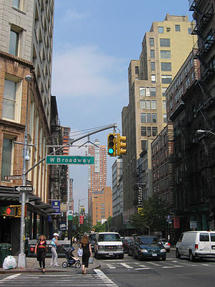
TRIBECA
Tribeca is a neighborhood in lower Manhattan, NYC. Its name is a portmanteau from “Triangle Below Canal Street”, although it s actual
shape is like a trapezoid. Its bounded by Canal Street, West Street Broadway and either Chambers or Vessey Streets.

Slide 9
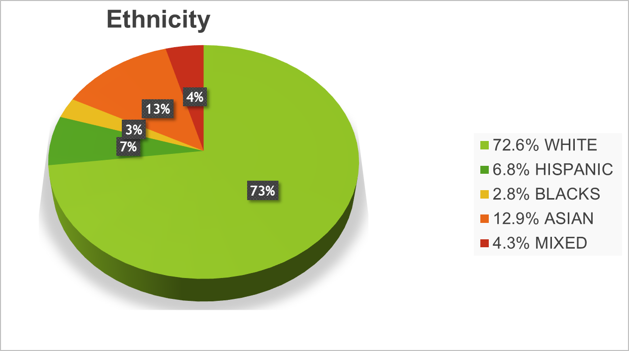
Demographics in Tribeca
Tribeca's median household income is $173,178
46% of residents have a BA degree
(Data Source: US Census 2000/NYC Department of City Planning)

Slide 10
Hypotheses:
More health-damaging ads in Harlem but
more health-promoting ads in Tribeca
More expensive products and services in
Tribeca
More advertisements featuring European Americans in Tribeca and more ads featuring African Americans in Harlem

Slide 11
-> 2 neighborhoods • Harlem • Tribeca
Procedure:
-> Split up into small groups
-> Survey each area (1 HOUR)
-> Photograph (ALL) Local Ads • no self-advertising

Slide 12
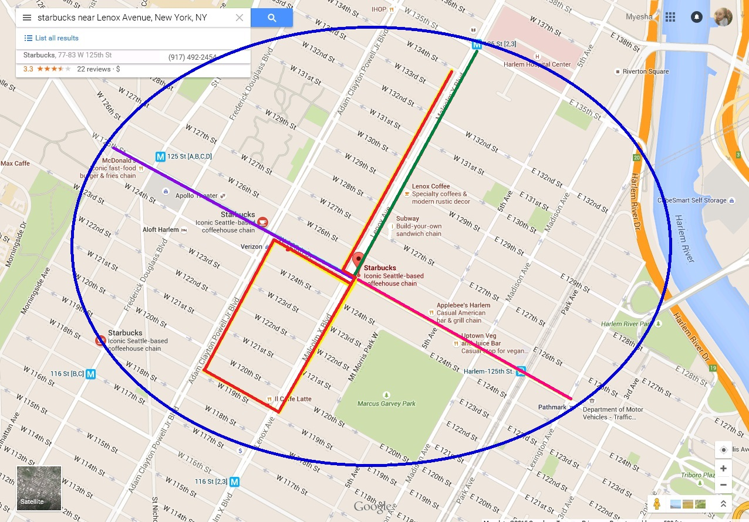
Walking Map - HARLEM

Slide 13
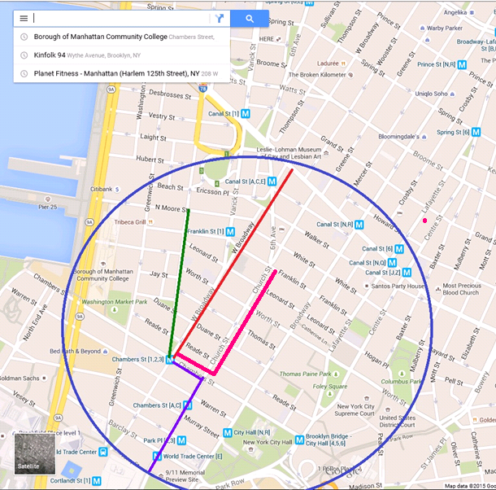
Walking Map - TRIBECA

Slide 14
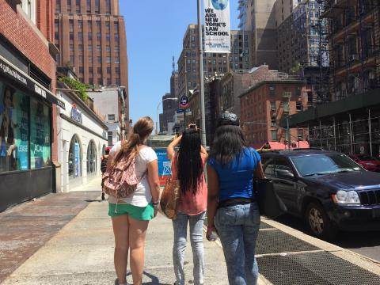
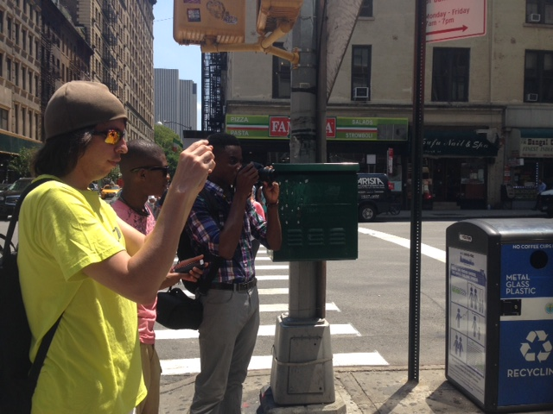
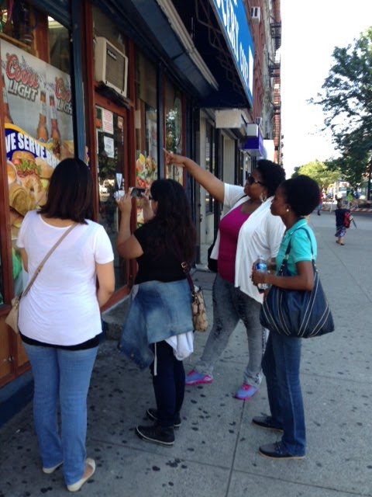
Taking ACTION…

Slide 15
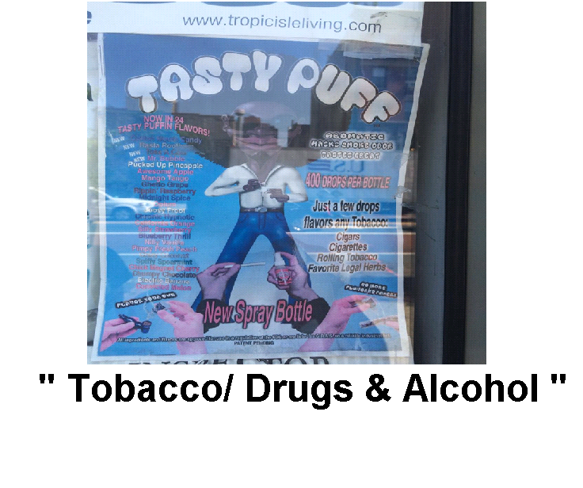
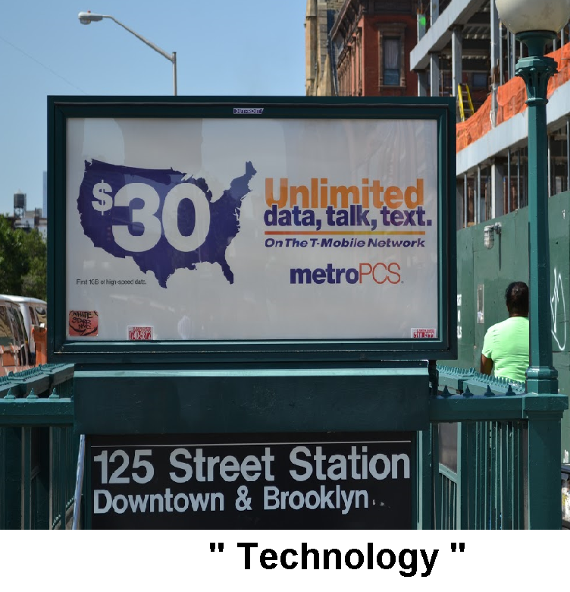
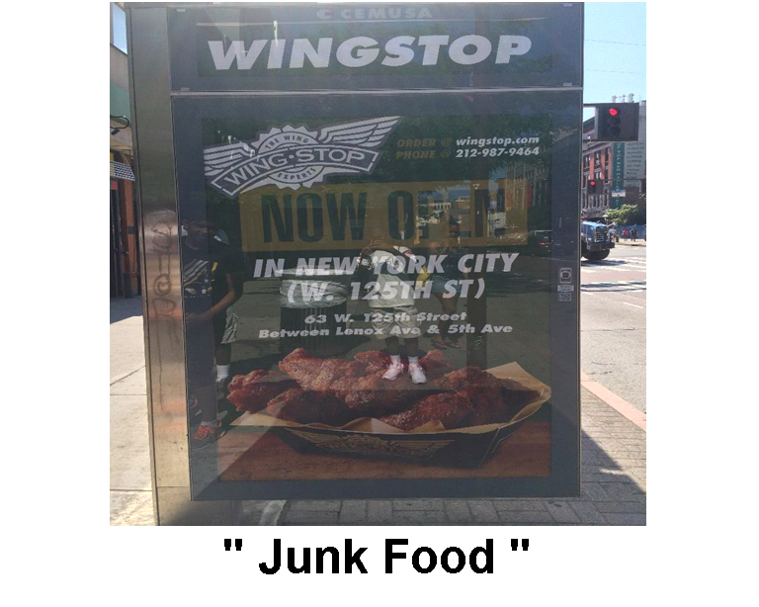
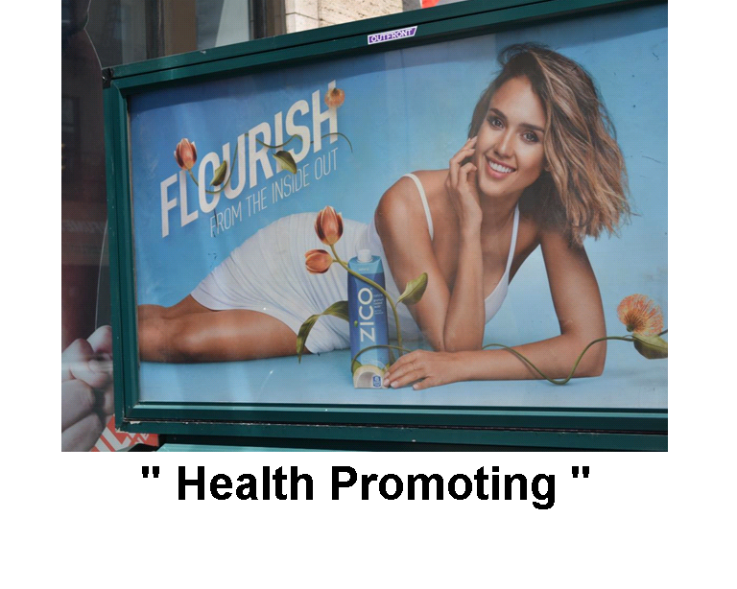
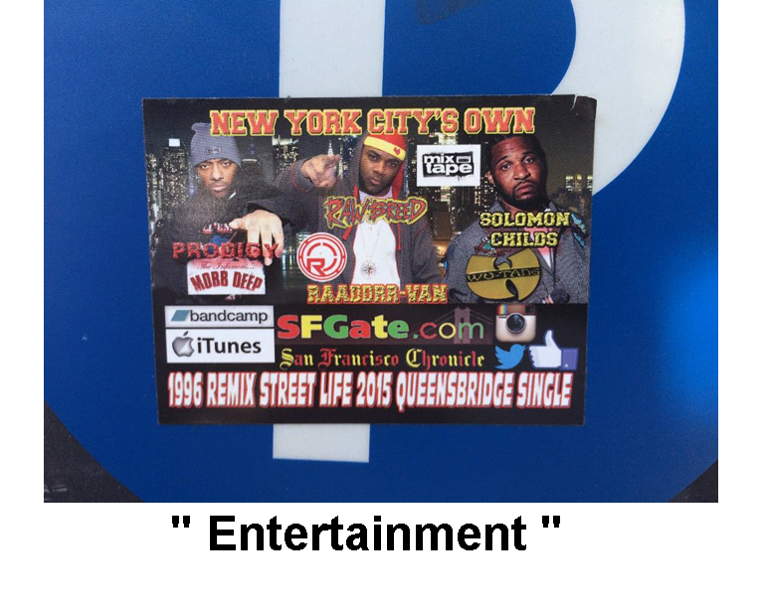
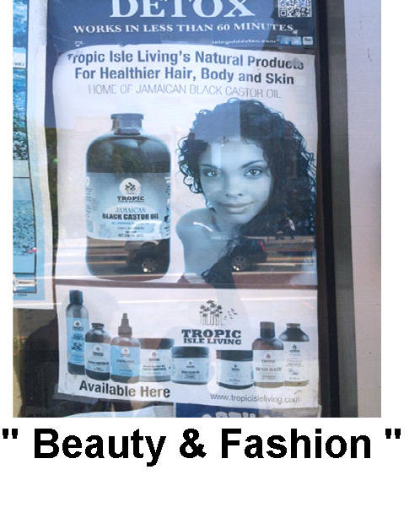
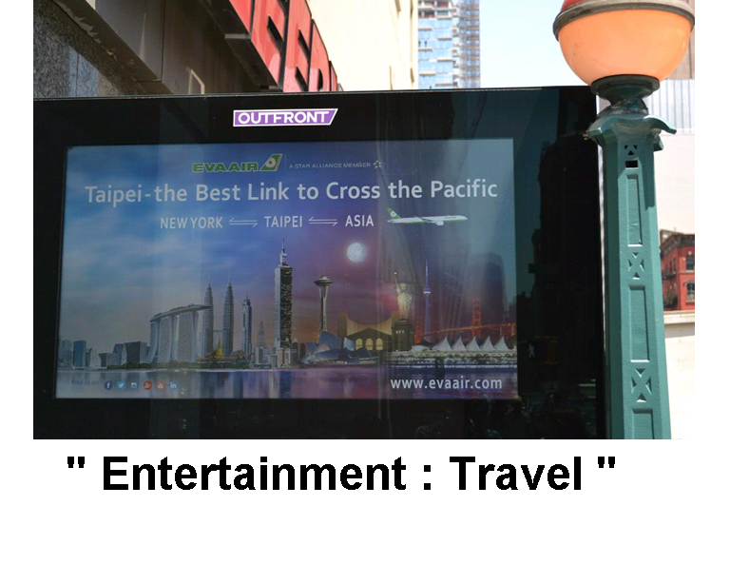
Scoring Data

Slide 16
Scoring Data: Ethnicity
Categories for scoring ethnicity represented in ads:
African American
European American
Asian American
Other

Slide 17
RESULTS: Density
 | HARLEM | TRIBECA
TOTAL DISTANCE | 1.3 miles | 1.1 miles
TOTAL ADS | 103 | 103
ADS PER MILE | 79 ads/mile | 93 ads/mile

Slide 18
RESULTS: CONTENT (Frequencies)
Content/ Type of ads | Harlem | Tribeca
Fashion | 7 | 6
Technology | 7 | 0
Public safety/ health | 25 | 21
Entertainment/ travel | 13 | 50
Junk food | 12 | 9
Alcohol/cigarettes | 28 | 13
Other | 11 | 4
χ ²(6) = 38.338, p < .001

Slide 19
RESULTS: CONTENT (Percentages)

Slide 20
RESULTS: Ethnicity Represented
Ethnicity of people represented | Harlem | Tribeca
African American | 12 | 17
European American | 10 | 68
Asian American | 1 | 11
Other | 2 | 14
χ ²(3) = 12.932, p= .005

Slide 21
RESULTS: ETHNICITY (Percentages)

Slide 22
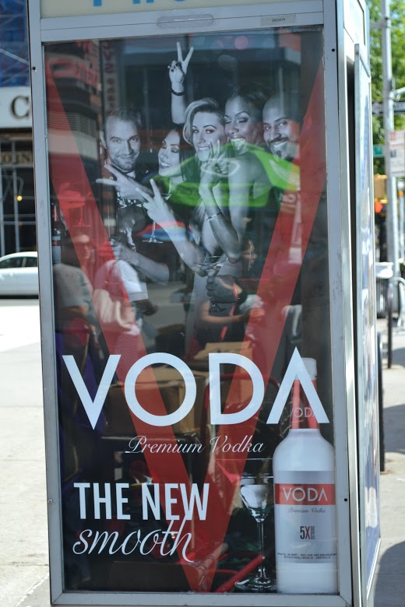
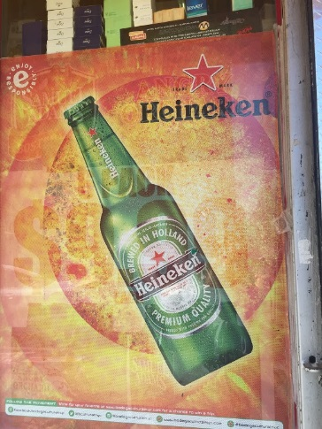
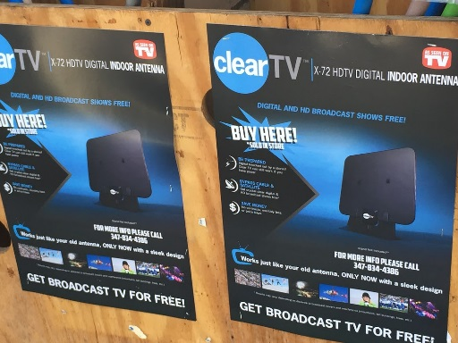
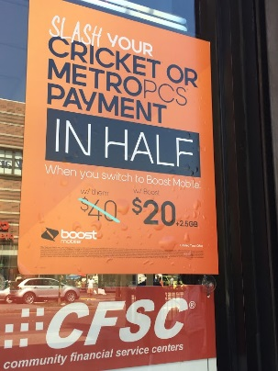
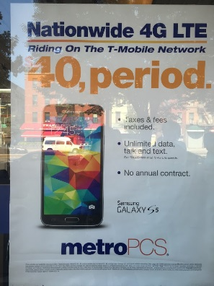
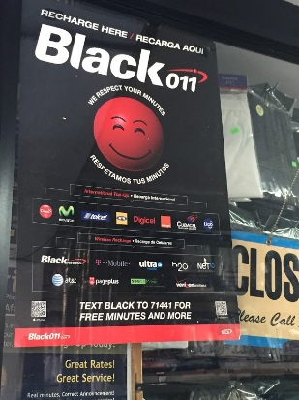
Summary
More alcohol advertisement in Harlem
More entertainment advertisement in Tribeca
Tribeca ads represented mostly Caucasians while Harlem ads represented a mix of African Americans and Caucasians
Surprisingly, we found slightly more health promoting ads in Harlem than Tribeca; only slightly more junk food ads in Harlem
Unexpectedly, there were more technology ads in Harlem

Slide 23

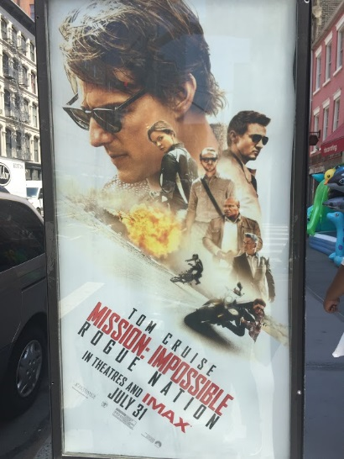
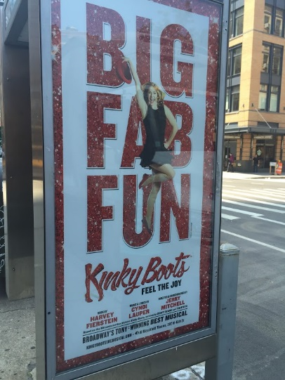
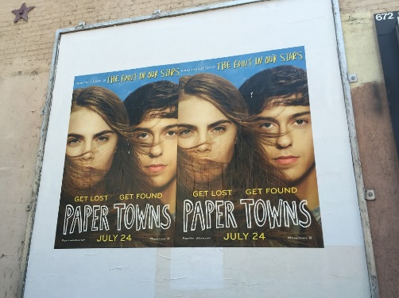
Discussion
Agencies target specific types of people in specific neighborhoods
Ex: alcoholic ads/entertainment ads
Harlem - blacks, Tribeca- whites, Hispanics?
No other health related differences
Community effort to in making a change
No technology ads found in Tribeca
Possibly because technology could be advertised online rather than the neighborhood itself
The technology advertised in Harlem was not advanced or expensive
Entertainment Ads
Notes:
Why – limitations, connections with audience
Alcoholic ads targeted those who lean towards alcohol – surondings, culture, problems
Consistent with previous research – not sure why

Slide 24
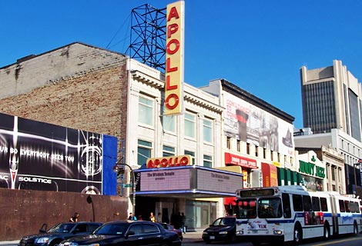
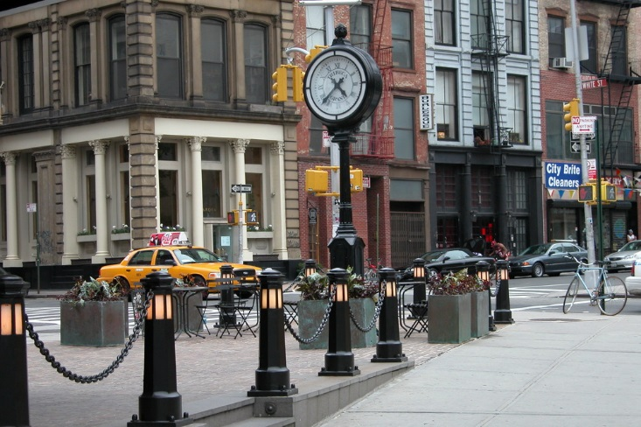
Limitations:
Chosen neighborhoods
Limited area covered; randomly chosen blocks
Potential errors in scoring
(Ex: in identifying ethnicity)
no inter-rater reliability
Different groups decided whether or not something was an advertisement
Harlem
Tribeca
Notes:
The place we visited in Harlem was wealthier than the actual rough places of Harlem and that all factors in towards our results
Lack of differences b/c of chosen neighborhoods
Schedule and location restraints

Slide 25

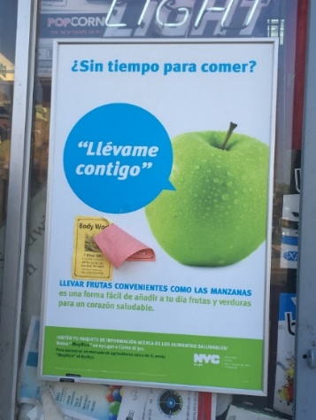

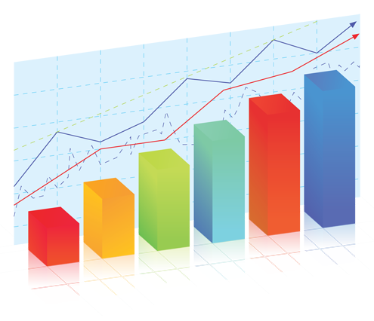
Implications and Future Directions
Although neighborhood targeting of health related ads may be decreasing, we should continue striving to bring this information to the awareness of the public
Advertisement should be more diverse and attempt to target all the minorities
Future directions:
More thorough coverage of the area
More detailed analysis
More accurate scoring
Notes:
individual and communal levels
Attempt to publish/ share with media

